Slide 1
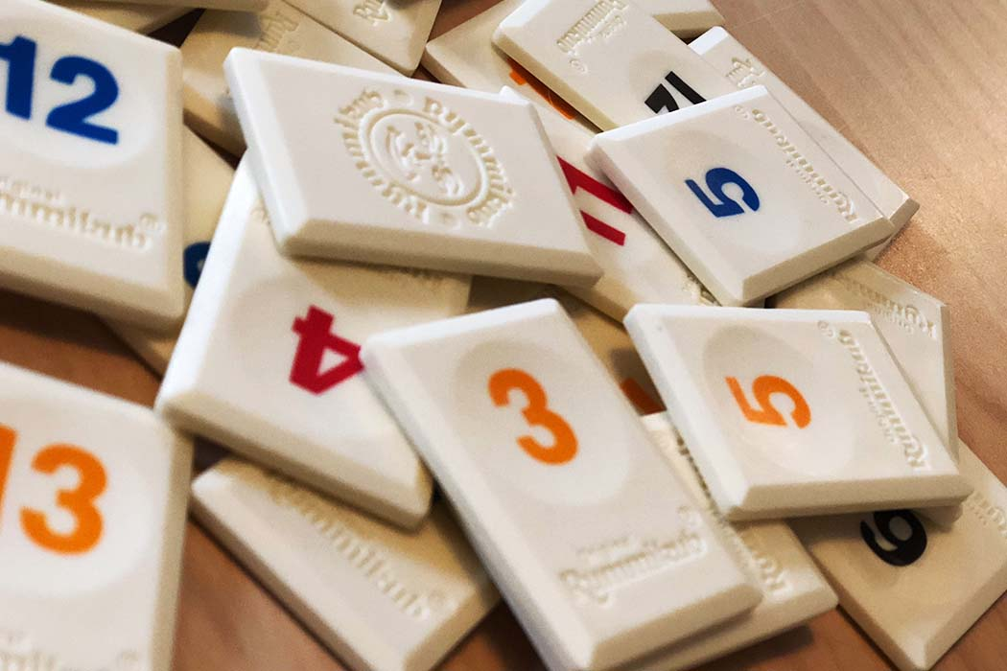
Java Rummikub Game
Mark Vance

Slide 2
Overview
Goal:
Create a local four player Rummikub Game
Draggable tiles
Sorting function for player hands
Snapping tiles to each other

Slide 3
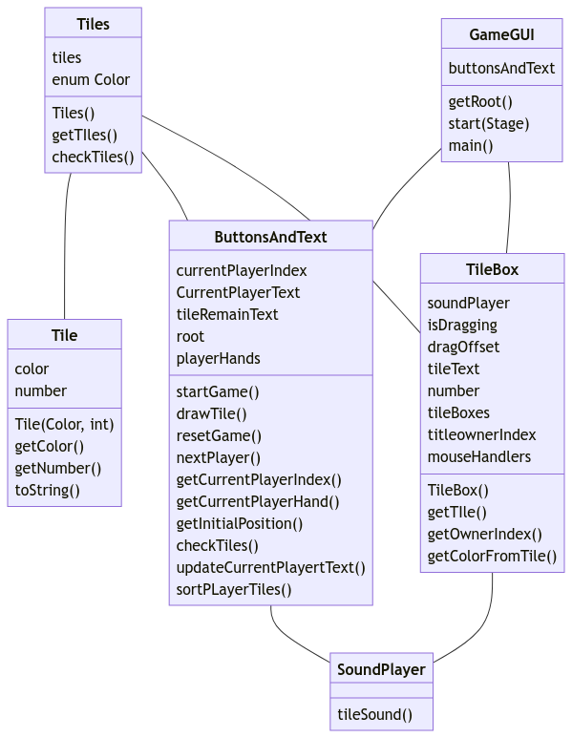
UML Diagram

Slide 4
GUI
GUI made using JavaFX
Coded using Visual Studio Code
GUI elements consists of:
Window w/ black background
Green rectangle for play area
Three separate vboxes for player actions, game actions, and text boxes

Slide 5
What Have I Learned
Rectangles
I dug into mouse events here to see what I could do with the actual game tiles, there is a lot more that I could do, and I will probably continue to work on this for fun
Importance of code organization
Often during the process, I found myself scrolling through many lines of code to find one thing I saw an hour earlier and forgot about

Slide 6
Future Improvements
Snapping tiles to each other
I removed this in a recent commit because it was messing with the spacing on the UI elements. Focused on other elements before adding the grid back and ended up not having time to fix
Organization
Realized after putting together many pieces that planning more ahead of time would help to not over complicate the code
Game logic
Board checking for valid placements
Scoring and end game
Player’s can only move board tiles and their own hand (ex player 1 grabbing from player 3’s hand can happen now)
UI Color themes
Online Play

